Slide 1

Course DA-624 Project Presentation on Enhancing Mental Health Support through Conversational AI: Fine-tuning google-t5-base model mental health conversational dataset
Indian Institute of Technology Guwahati
Team 13 Rohit Sharma (234156029)
Jitender Singh (234156007)
Rahul Kumar (234156027)

Slide 2
Introduction
Brief overview of the project
Importance of mental health support
Introduction to Conversational AI and its potential in mental health care

Slide 3
Exact Problem Statement
Defining the specific problem addressed in the project
Highlighting the need for AI-driven solutions in mental health support
Our Approach

Slide 4
Description of Dataset
Overview of the mental health counseling conversations dataset used and sources of the dataset
Characteristics of the dataset

Slide 5
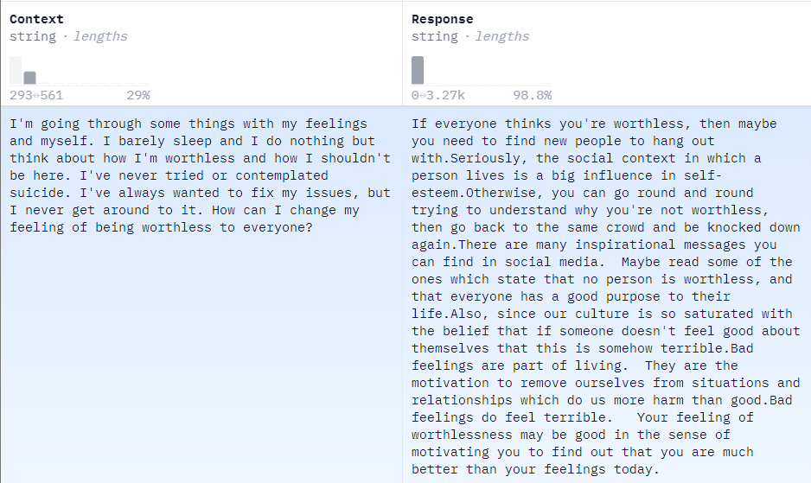
Screenshot of the Dataset example from Hugging Face website

Slide 6
Related Works/Literature Survey
Review of existing research in using AI for mental health support
Discussion of relevant studies, methodologies, and findings
Identification of gaps in the literature

Slide 7
Methodology
Preprocessing Steps
Fine-tuning process of the Google T5-base model
Hyperparameters

Slide 8
Preprocessing Steps
Data Loading and Class Definitions
Text Analysis with Tokenization
Preprocessing Functions
Dataset Creation and Tokenization
Human-Readable Output

Slide 9
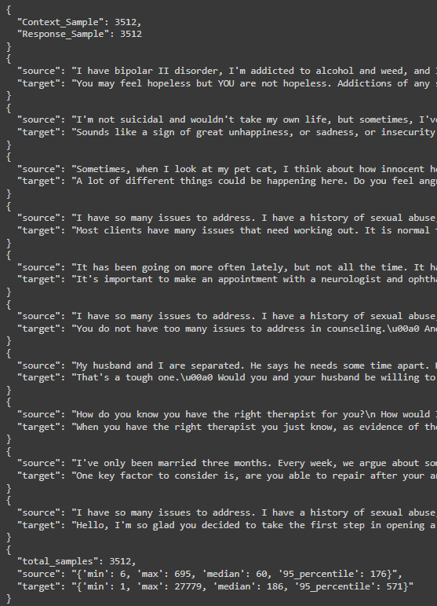
Preprocessing Output

Slide 10
Finetuning steps
Argument Parsing and Configuration:
Model Initialization and Configuration:
Lightning model class
Load the pre-trained Google T5 Base LLM model
Training Setup and Optimization
Apply LoRA Peft Parameters
Training Execution

Slide 11
Results
Varying learning rate for Adafactor Optimizer with
10 epochs
batch size of 16
LoRA
rank as 8
Scaling factor as 16
dropout as 0.1
Implications of BLEU Scores
Striking a Balance
Learning rate | BLEU score with full parameter finetuning | BLEU score with LoRA
0.0025 | 0.2931240397 | 0.08189787337
0.003 | 0.3336382796 | 0.09166584285
0.004 | 0.2778062405 | 0.09892989036
0.005 | 0.3140018837 | 0.1148693485

Slide 12
Conclusion
Learning rates
LoRA
Dataset Size
Implications and Future Directions

Slide 13
Thank You

